Slide 1

LLMs Hallucinations
Yoav Kor, Yuval Assif, Yuval Reuveni, Ohad Carmel
Advisors: Dr. Yuval Pinter, Mr. Nitay Calderon

Slide 2
Background
These days many people rely on language models for various tasks.
However, many language models provide incorrect answers with full confidence and without any disclaimers.
Currently, there is no method that allow the user to estimate the reliability of the answer that the model provides.

Slide 3
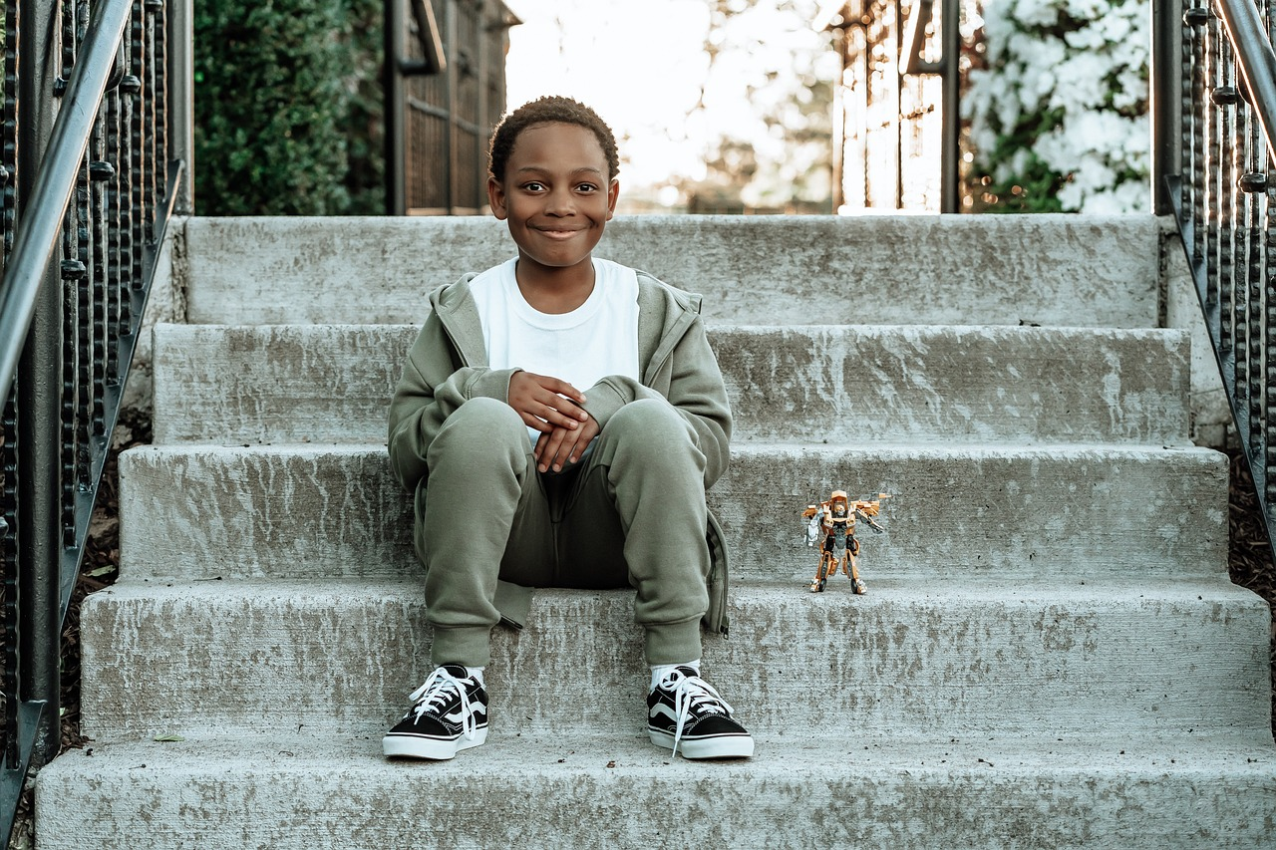

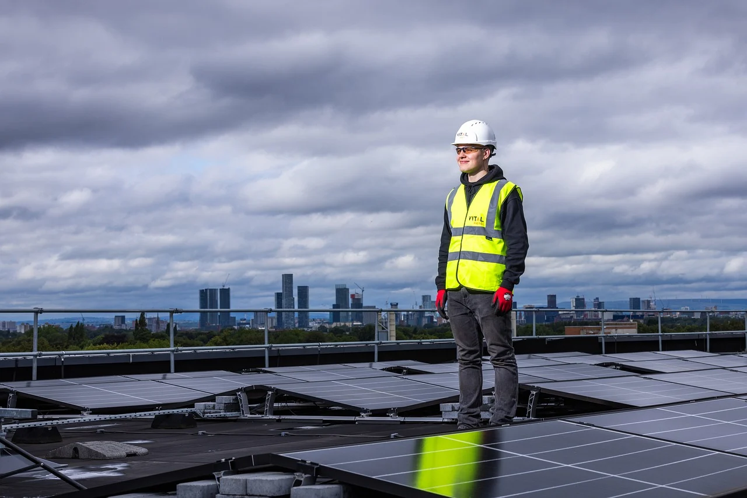
Background - Terminology
Hallucinations in LLMs occur when models generate responses that are factually incorrect or inaccurate.
Hedging is the term for when LLMs express doubt using phrases like “appears to be…” and “probably”
Notes:
Even when a model uses hedging, it is not always directly correlated to the hallucination of the model.
Hallucination also occur when a LLM tries to describe visualized data such as images.
In the next slides we will show several examples for pictures and their descriptions generated by LLM model.

Slide 4
Background
In our project, we focused on a vision language model (Llava) which takes an image as an input and outputs a description of it.
Let’s see some examples…

Slide 5
The image features a man standing on a roof wearing a high-visibility vest.
He is holding his hands up, possibly preparing to take a photograph.

Slide 6
The image features a man and a woman sitting on a stone wall overlooking the ocean.
They both have sunglasses on, and the woman is smoking a cigarette.

Slide 7
The image features a young boy sitting on the bottom step of a staircase, with a toy in his hand.
The toy appears to be a robot-like figure, and the boy is holding it with affection

Slide 8
Even when a model uses hedging, it is not always directly correlated to the hallucination of the model.
The image features a young boy sitting on the bottom step of a staircase, with a toy in his hand.
The toy appears to be a robot-like figure, and the boy is holding it with affection

Slide 9
Project Efforts
Experiment
Detection Model

Slide 10
The Experiment
Goal: Test how hallucinations and hedging impact the model’s trustworthiness in continuous interaction with humans.

Slide 11
The Experiment flow
An image description generated by LLM is displayed on screen.
A statement regarding the image description is displayed.
The participant should answer True/False and choose how many coins he is willing to bet on his answer (meaning how much he trusts the model’s description).
Before proceeding to the next image description and its statements, the user gets feedback on his answers.

Slide 12
Points: 0
Model A
Text Description
Probe
True
False
0
100
How many points would you bet on your response

Slide 13
Points: 0
Model A
Step 1: An image description generated by LLM is displayed on screen.
The image captures a heartwarming moment between a woman and a young child. The woman is sitting down and kissing the child on the forehead. They are both wearing green jackets, which adds a touch of color to the scene. In addition to the woman and the child, there is also a handbag placed in the background, possibly belonging to one of the individuals in the scene. The overall atmosphere of the image is warm and affectionate.
True
False

Slide 14
Points: 0
Model A
Step 2: A statement regarding the image description is displayed.
The image captures a heartwarming moment between a woman and a young child. The woman is sitting down and kissing the child on the forehead. They are both wearing green jackets, which adds a touch of color to the scene. In addition to the woman and the child, there is also a handbag placed in the background, possibly belonging to one of the individuals in the scene. The overall atmosphere of the image is warm and affectionate.
The woman is sitting down
True
False

Slide 15
Points: 0
Step 3: The participant should answer True/False.
Model A
The image captures a heartwarming moment between a woman and a young child. The woman is sitting down and kissing the child on the forehead. They are both wearing green jackets, which adds a touch of color to the scene. In addition to the woman and the child, there is also a handbag placed in the background, possibly belonging to one of the individuals in the scene. The overall atmosphere of the image is warm and affectionate.
The woman is sitting down
True
False

Slide 16
Points: 0
Model A
Step 4: The participant should choose how many coins he bets on his answer.
The image captures a heartwarming moment between a woman and a young child. The woman is sitting down and kissing the child on the forehead. They are both wearing green jackets, which adds a touch of color to the scene. In addition to the woman and the child, there is also a handbag placed in the background, possibly belonging to one of the individuals in the scene. The overall atmosphere of the image is warm and affectionate.
The woman is sitting down
True
False
0
100
How many points would you bet on your response

Slide 17
Points: 0
Model A
The image captures a heartwarming moment between a woman and a young child. The woman is sitting down and kissing the child on the forehead. They are both wearing green jackets, which adds a touch of color to the scene. In addition to the woman and the child, there is also a handbag placed in the background, possibly belonging to one of the individuals in the scene. The overall atmosphere of the image is warm and affectionate.
The woman is kissing the child on the forehead
True
False

Slide 18
Points: 0
Model A
The image captures a heartwarming moment between a woman and a young child. The woman is sitting down and kissing the child on the forehead. They are both wearing green jackets, which adds a touch of color to the scene. In addition to the woman and the child, there is also a handbag placed in the background, possibly belonging to one of the individuals in the scene. The overall atmosphere of the image is warm and affectionate.
The woman is kissing the child on the forehead
True
False

Slide 19
Points: 0
Model A
The image captures a heartwarming moment between a woman and a young child. The woman is sitting down and kissing the child on the forehead. They are both wearing green jackets, which adds a touch of color to the scene. In addition to the woman and the child, there is also a handbag placed in the background, possibly belonging to one of the individuals in the scene. The overall atmosphere of the image is warm and affectionate.
The woman is kissing the child on the forehead
True
False
0
100
How many points would you bet on your response

Slide 20
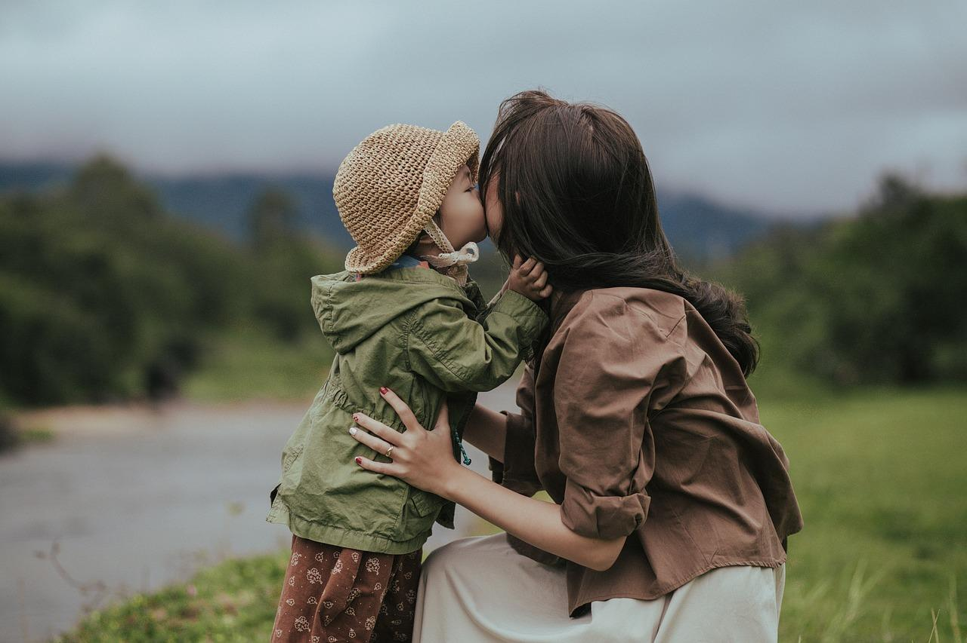
Points: -20
Before proceeding to the next image description and its statements, the user gets feedback on his answers.
You won the 40 points you bet on the statement that the woman is sitting down
You lost the 60 points you bet on the statement that the woman is kissing the child on the forehead
YOU HAVE LOST 20 POINTS

Slide 21


Slide 22
Data Preparation
Hundreds model-generated descriptions of images with manually-tagged hallucinations and hedging.
Creating 4 probes for each image based on the generated description and manually tag it with True/False labels.

Slide 23
The Experiment Implementation
Technologies Used:
React:
Built the dynamic and responsive front-end.
Utilized Material-UI for styling.
Node.js:
Powered the back-end server.
Handled asynchronous operations.
Mongoose:
Interacted with MongoDB.
Simplified data modeling and validation.
Key Features:
Dynamic Flow:
Real-time updates based on user input.
Data Management:
Robust storage and retrieval with MongoDB.
User Interface:
Intuitive design using React and Material-UI.

Slide 24
The Detection Model
Goal: Find a way to tell when the LLM hallucinates.
We aim to manage to predict for each word (each token actually), if it is a hallucination or not.

Slide 25
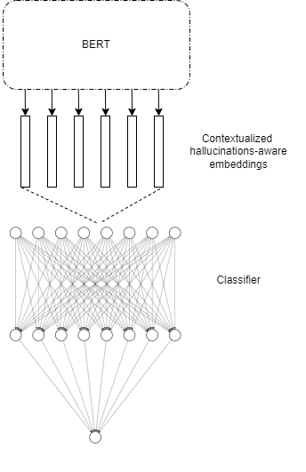
Model Structure
To solve this, we propose to fine-tune a pre trained BERT model with auxiliary classification feed forward neural network head.
Classifier FFN consists of 3 layers and the last layers is a single neuron represents the token hallucination logit.
Notes:
Few words about BERT

Slide 26
BERT
Input: Llava description of the image
Output: Embeddings vector

Slide 27
The Classifier
Input:
Embeddings’ vectors encoded by BERT
The logits (probabilities) that were given to the original word (token) by the LLM.
Output: Probability that the word is a hallucination

Slide 28
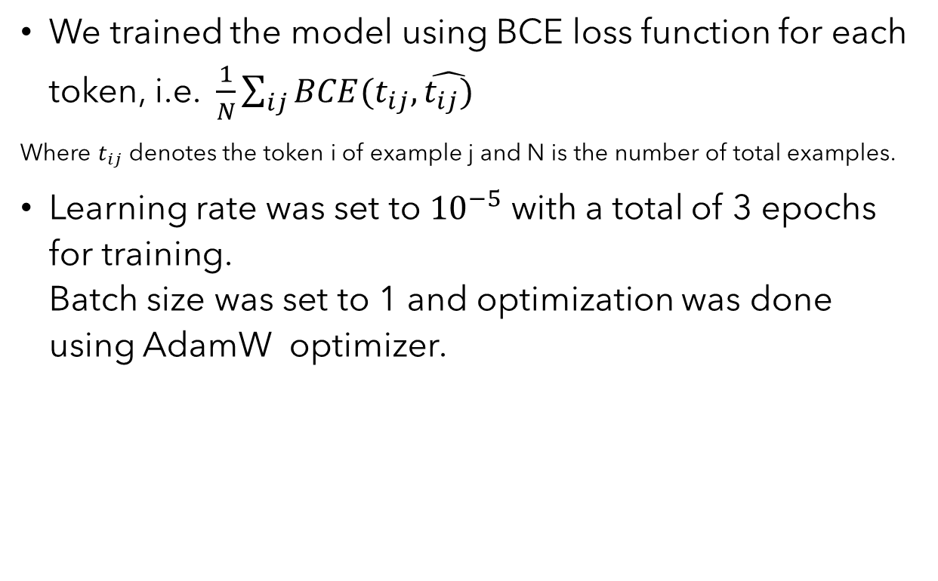
Model Training
We trained the model using BCE loss function for each token, i.e. $\frac{1}{N}\sum_{ij}{BCE(t_{ij}, \hat{t_{ij})}}$
Where $t_{ij}$ denotes the token i of example j and N is the number of total examples.
Learning rate was set to ${10}^{−5}$ with a total of 3 epochs for training. Batch size was set to 1 and optimization was done using AdamW optimizer.

Slide 29
Results
Experiment – TBD
For model evaluation we use the F1 metric which provides a desired balance between precision and recall

Slide 30
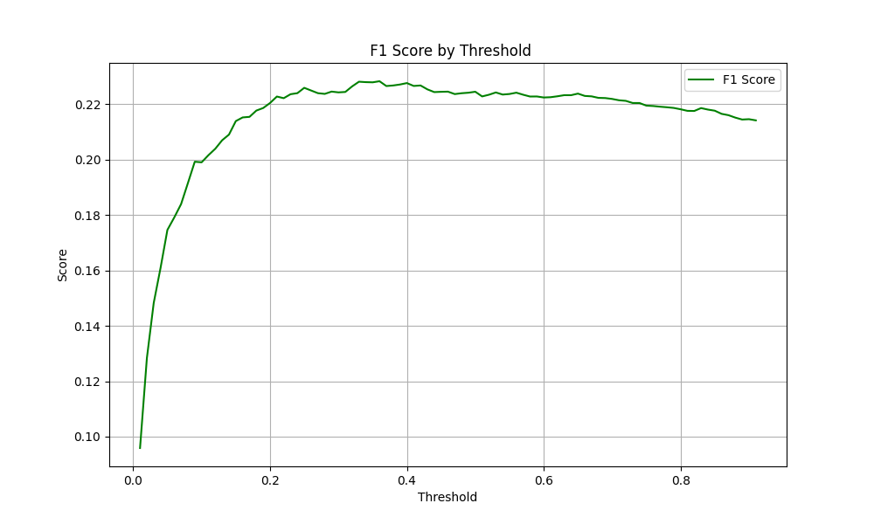
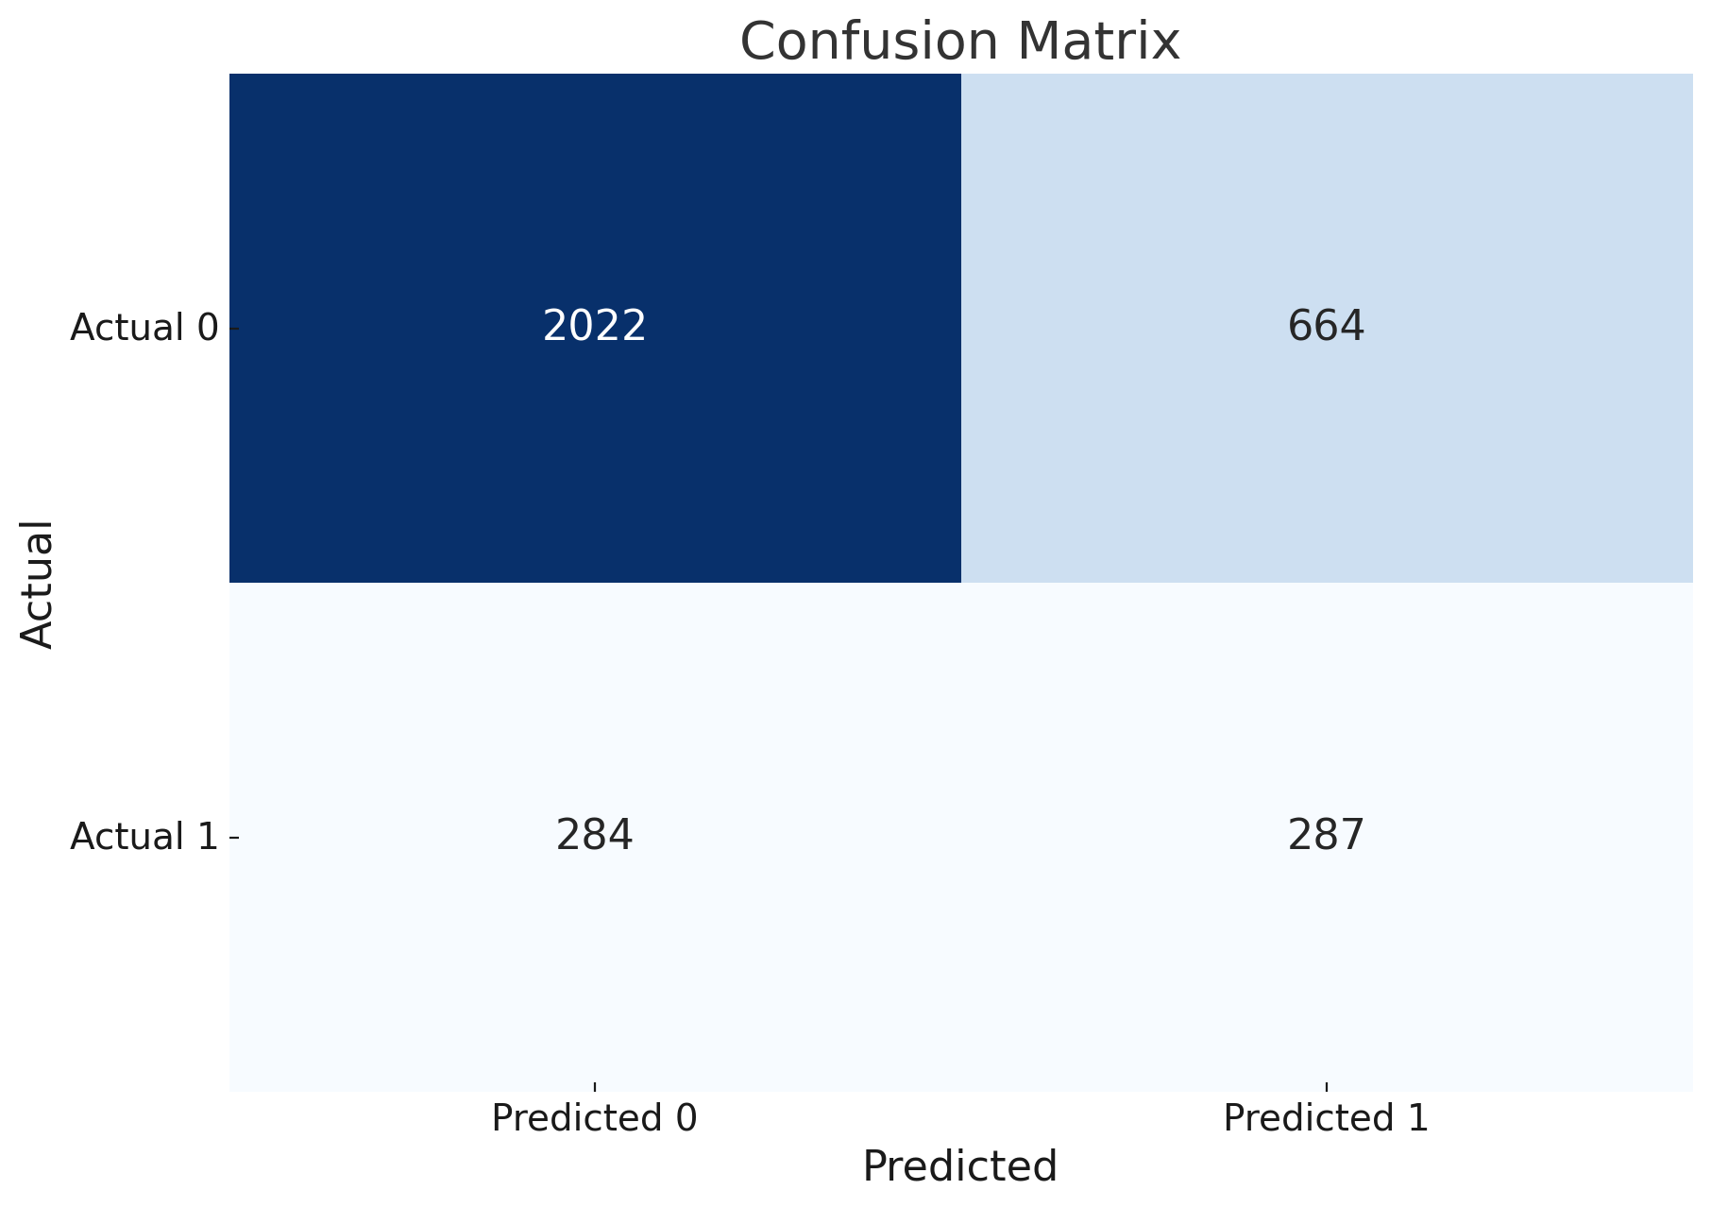
Baseline Model
Ours
F1 score: ~0.59

Slide 31
Let’s see some examples…

Slide 32
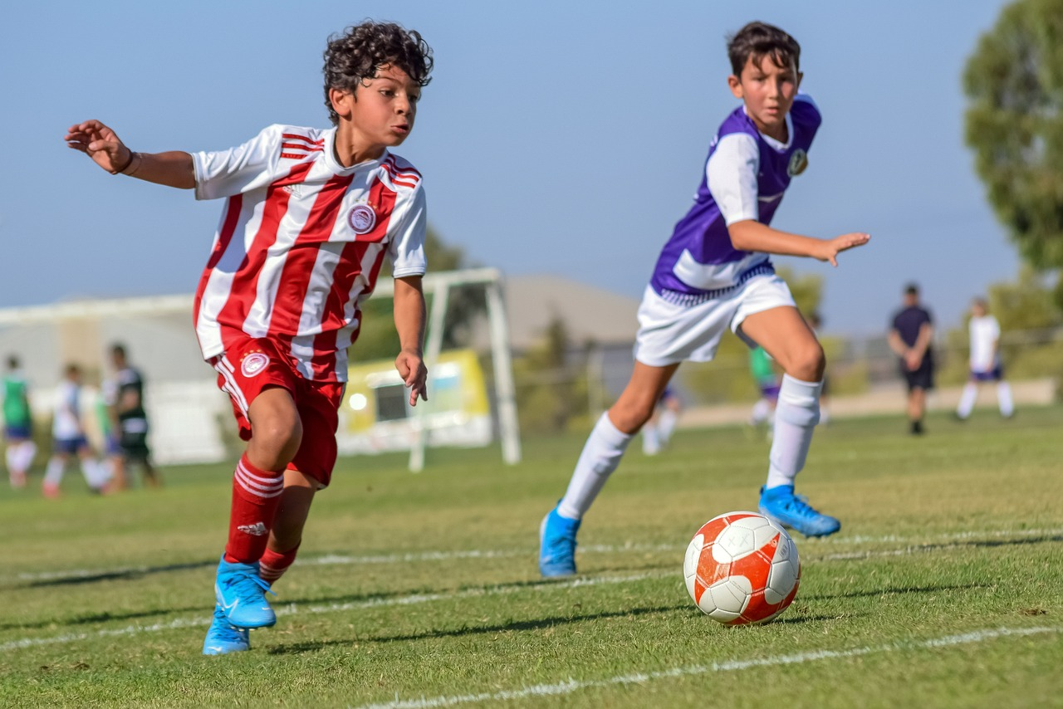
False Negative False Positive True Positive
Better than us?
In the image , two young boys are playing soccer on a field . one boy is wearing a red and white striped jersey , while the other one is wearing a black and purple striped jersey . they both seem to be running towards the soccer ball , which is placed towards the center of the field . there is also a group of three other people watching the game , standing near the edge of the field , possibly as spectators or waiting for their turn to play . overall , the scene represents an exciting moment during a soccer match .

Slide 33
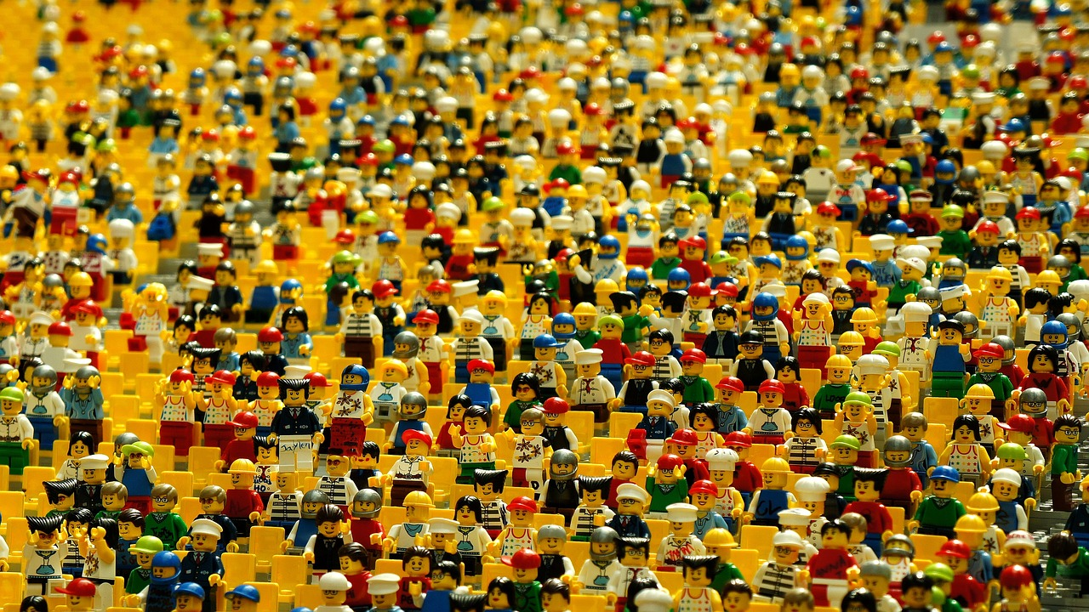
False Negative False Positive True Positive
Better than us?
the image is a large , detailed collage of various lego people . the lego figures are arranged in rows , creating a sense of unity and organization . the people are of different sizes and poses , showcasing the diversity of the lego characters . the collage is a vibrant and engaging display of lego people , capturing the essence of the popular toy.

Slide 34
Plans for the Future
Now the predictions are on token level. We plan to create a post-processing heuristic-based mechanism that determines whether a sequence of words (a span) is a hallucination or not.
Improve the model score:
Although we provided a baseline model and an algorithm that beats the baseline in terms of F1 score, we believe that further research might produce even better results.
Some improvement ideas:
Use more data (using even multiple VL models)
Use more Features - using not just logits but also embeddings from inner layers of the model, using autoregressive model for encoding, adding POS at the token level etc.

Slide 35
Thank you

